Slide 1
Stitches. Ouch.
A multi-brand design system for Gap inc.

Slide 2

Sketch! Bless you.
Adoption rate for the sketch libraries was fairly low, around 50% among central UX and less than 10% for brands.
Deltas between core-ui and libraries are big. Naming,

Slide 3


1. Intro
Choose one approach to grab the audience’s attention right from the start: unexpected, emotional, or simple.
Unexpected Highlight what’s new, unusual, or surprising.
Emotional Give people a reason to care.
Simple Provide a simple unifying message for what is to come

Slide 4
How many teams Gap have
building their own front-ends and repos?

Slide 5
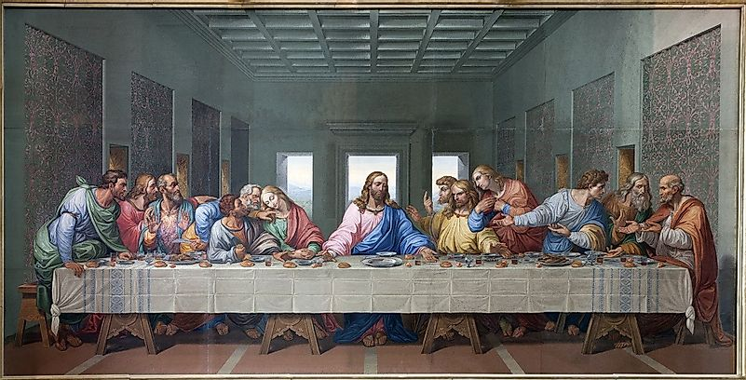
Twelve!
one for each brand, factory brand, MFE.

Slide 6

The Google Translate app can repeat anything you say in up to NINETY LANGUAGES from German and Japanese to Czech and Zulu
Tip
Don’t wait till the end of the presentation to give the bottom line.
Reveal your product or idea (in this case a translation app) up front.

Slide 7
2. Examples
By the end of this section, your audience should be able to visualize:
What What is the pain you cure with your solution?
Who Show them a specific person who would benefit from your solution.

Slide 8
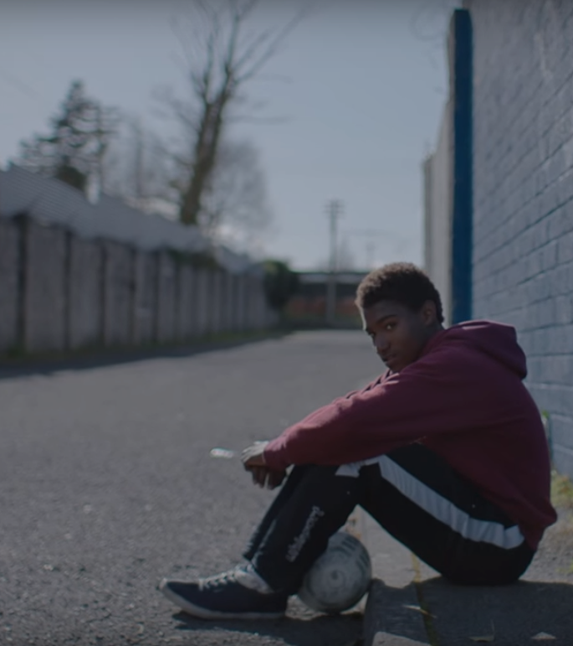
Meet Rishi.
He’s designing with Photoshop new content for a homepage carousel. He crawls the website and notices that there are seven carousels with slightly different features.
He timidly looks into the Sketch library and notices no carousels are available.
Handing off the new designs he gets blocked by dev; that carousel component is not compatible with the page.

Slide 9

Meet Johnee.
He needs to build a new slider for the homepage but he needs to guess motion and accessibility affordances.
He finds an example in Storybook that can be retrofitted, but dependencies seem outdated.
He gets blocked by central UX because designs are not using updated components.
Story for illustration purposes only

Slide 10
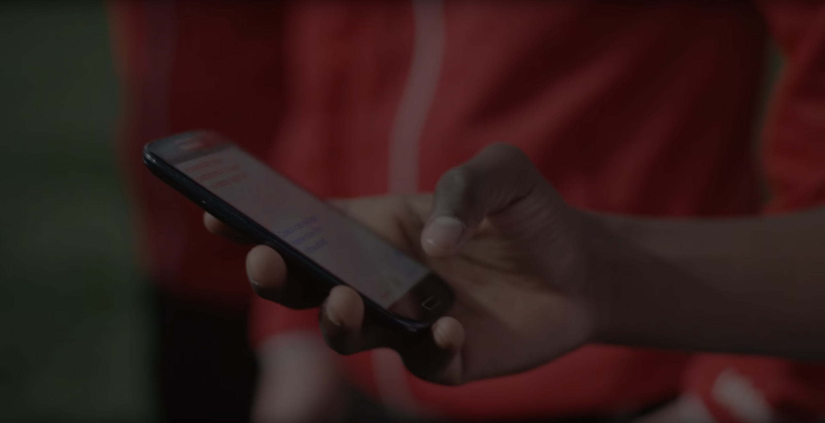
An informational gap* has prevented devs and designers from delivering their solution.
*pun intended

Slide 11

Then, Marcos discovered Google Translate
He has his visiting customers speak their camera issues into the app.
He’s able to give them a friendly, personalized experience by understanding exactly what they need.

Slide 12
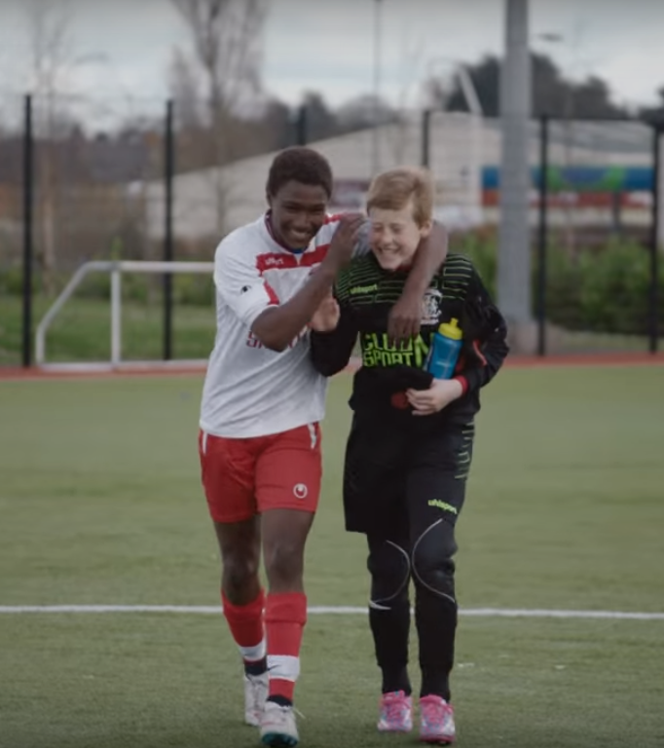
A simple gesture
Coaches Gary and Glen knew no Spanish.
They used Google Translate to invite Alberto to join in... “Do you want to play?”... “Can you defend the left side?”
Tip
Show how your solution helps the person in the story reach his or her goals.

Slide 13
From Stickersheets to Figma components.
Stitch has now 90% parity with codebase and documentation in Confluence.
Tip
Stories become more credible when they use concrete details such as the specific complex moves Alberto learned through Translate and his 30 goals in 21 games performance stats.

Slide 14
3. Examples
People need to understand how rare or frequent your examples are.
Pick 1 or 2 statistics and make them as concrete as possible. Stats are generally not sticky, but here are a few tactics:
Relate Deliver data within the context of a story you’ve already told
Compare Make big numbers digestible by putting them in the context of something familiar

Slide 15
It’s no surprise Marcos uses Google Translate in his shop regularly.
There are 23 officially recognized languages in the EU.
Tip
Don’t let data stand alone. Always relate it back to a story you’ve already told, in this case, Marco’s shop.
Source: theguardian.com

Slide 16


More than 50 million Americans travelled abroad in 2015
THAT’S MORE THAN THE POPULATION OF
CALIFORNIA AND TEXAS COMBINED
Tip
When a number is too large or too small to easily comprehend, clarify it with a comparison to something familiar.
Source: travel.trade.gov

Slide 17
4. Closing
Build confidence around your product or idea by including at least one of the these slides:
Milestones What has been accomplished and what might be left to tackle?
Testimonials Who supports your idea (or doesn’t)?
What’s next? How can the audience get involved or find out more?

Slide 18
Milestones
Aug 2019
Sept 2020
Feb 2021
Oct 2019
Feb 2021
Dec 2021
Library gets audited
Figma Kicks in w/
new libs
CMS for AT
Translate conversations through your Android watch
Sketch libraries in parity
Documentation shows
in figma

Slide 19
What people are saying
With this app, I’m confident to plan a trip to rural Vietnam
Wendy Writer, CA
Visual translation feels like magic
Ronny Reader, NYC
Translate has officially inspired me to learn French
Abby Author, NYC
Quotes for illustration purposes only

Slide 20

Know a 2nd language? Make Google Translate even better by joining the community.
Tip
Inspire your audience to act on the information they just learned.
Depending on your idea, this can be anything from downloading an app to joining an organization.

Slide 21
Good luck!
We hope you’ll use these tips to go out and deliver a memorable pitch for your product or service!
For more (free) presentation tips relevant to other types of messages, go to heathbrothers.com/presentations
For more about making your ideas stick with others, check out our book!

